Slide 1

Capstone 2 Presentation

Slide 2
Context
This dataset was county level data for demographics, job, and education.
The data was put together from two separate datasets that were joined together.
The first dataset came from census data and the second one was a dataset found on Kaggle.

Slide 3

Criteria of Success
In this analyses I wanted to know which features had the greatest effect on income. I wanted the results of this analyses to be able to form an understanding of what features in a county led to greater prosperity.

Slide 4
Constraints
Environmental and real estate data were not present for this analyses
I did not pull the education data by age for this project
I don’t have county tax or budget data

Slide 5
Data Sources
https://data.census.gov/table/ACSST1Y2021.S1501 – This is the census data I got the education data from
https://www.kaggle.com/datasets/muonneutrino/us-census-demographic-data?select=acs2015_county_data.csv – Any non-education data came from this data set

Slide 6
Data Wrangling process
There were 3220 counties in the county demographics data set
There 830 counties in the county education data set
From the education dataset I pulled the education data for percent of high school graduates for males and female and then the percent of college graduates for males and females for each county
I also pulled the total high school and college graduates percentage
After joining the data there were 802 counties left in the new dataset

Slide 7

Predictions About the Data
Higher rates of education would lead to higher income
Work from home percent will have a strong correlation with income
Mean commute will have a positive correlation with income

Slide 8
EDA - Correlations
As expected, education does have a strong positive correlation with income and a stronger correlation with Income Per capita
Work from home percent showed to have a moderate correlation with income
Mean commute had a moderate to almost strong correlation with income

Slide 9
Models used
Regression
K-Means Classification
DBSCAN

Slide 10
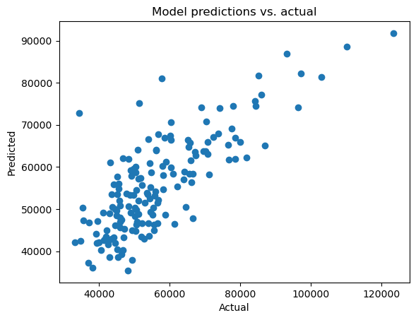
Regression
Model used – OLS from the statsmodel.api library
The regression model showed an R² value of .656 using only Total Percent bachelor's degree or higher and MeanCommute features

Slide 11
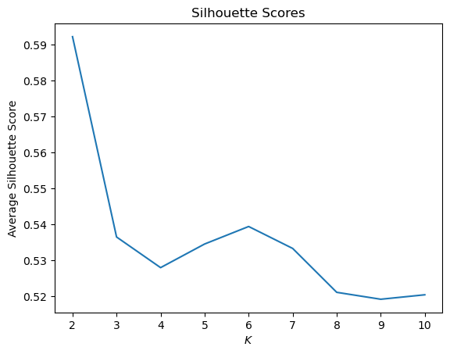
K-Means Classification
The highest silhouette score was at 2 clusters followed by a drop off
The next highest peak was at 6 clusters
We got the best results using the same features as in our regression model [Total Percent bachelor's degree or higher and MeanCommute]

Slide 12

DBSCAN
DBSCAN was run using a grid search
DBSCAN was not able to identify any distinct clusters
I tried running DBSCAN using multiple variations on used features and there was no satisfactory clustering discovered

Slide 13

Conclusions
Education seems to be the greatest determinant of income in this dataset
This dataset does fit neatly into clusters as demonstrated by the clustering algorithms run
More data is needed to be able to differentiate the counties into groups that can indicate the factors of prosperity
It is also possible that counties are too large, and that the data would be more telling if it were more granular, down to the city level.

